Slide 1
MILD-Master Stimuli
Timing and processing flow diagram

Slide 2
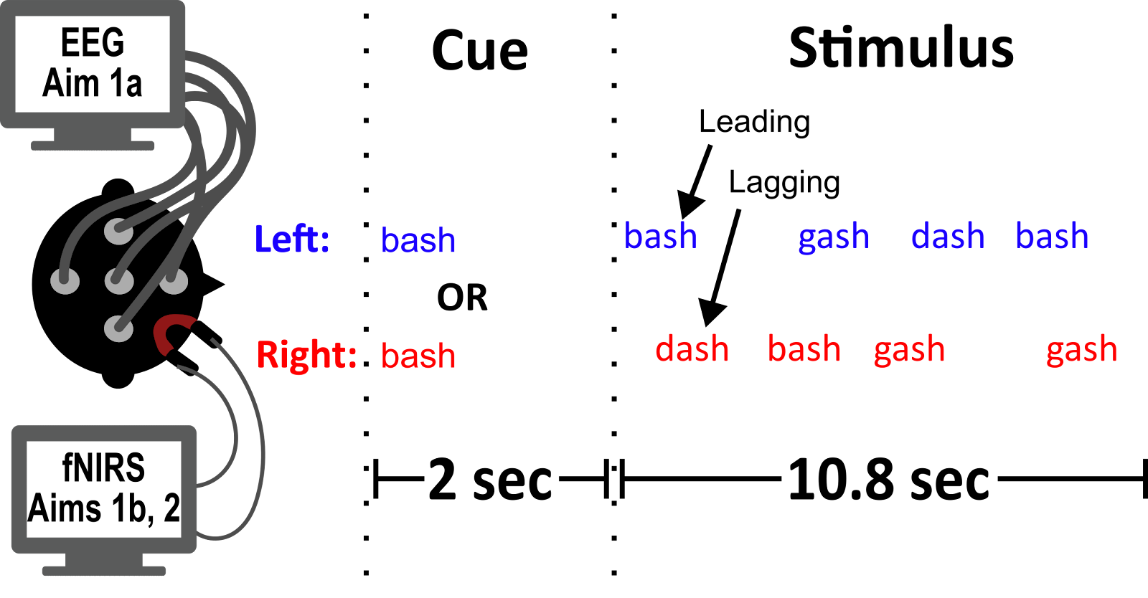
500 ms
?
50 ms
?
250 ms
9.6
?
8 token pairs * 800 ms/pair = 6.4 sec

Slide 3
Questions/To Dos
Target/Masker lead for the whole thing → First ERP dilemma
Only attenuation for ILD magnification?? Half and Half attenuation/amplification?
Number of trials
Alpha
NIRS
ERPs
Ensure ILDs only for ILD condition
Maximum number of bashs/Distance between Bashs (DOUBLE CHECK)
Currently: No bashs within 2 indices of each other (in either target or masker)
Bash cannot occur in masker when it occurs in target
Bash cannot occur on the first OR last token pair
Smoothing filter → I hear the intensity transitions in Magnified
Min/max number of bashs: 2-4
Write all word orders to a csv
Plot gain tracks for ild mag

Slide 4
Stimulus generation flow diagram (for each condition, for each trial….)
Create order of dashs and gashs for target and masker streams
Generate indices of bashs for both streams, with constraints. Replace existing dash or gash at selected indices in both streams
Loop through individual words and append sound waveforms to target/masker arrays, including delays
Spatialize target, masker and cue
- If ITD, delay contra ear
- If ILD, apply HRTF mag sp.
- If ILD Mag, apply full HRTF to calculate ITDs, then apply ILD magnifiication to HRTF mag. sp. Signal WITH ATTACK
Concatenate left channel data (cue, ISI data, target + masker) and same for right channel data
Write to file

Slide 5
Example Stimuli

Slide 6

What if we change the between word pair delay (all examples ITD500, within word delay = 250)
0 ms
50 ms
100 ms
250 ms

Slide 7
What if we change the within word pair delay (all examples ITD500, between word delay = 100 ms)
100 ms
250 ms
300 ms
400 ms

Slide 8
ILD Azimuth? (between delay = 100, within delay = 250)
Natural | Magnified
0 | 0
10 | 10
20 | 20
30 | 30
70 | 70

Slide 9
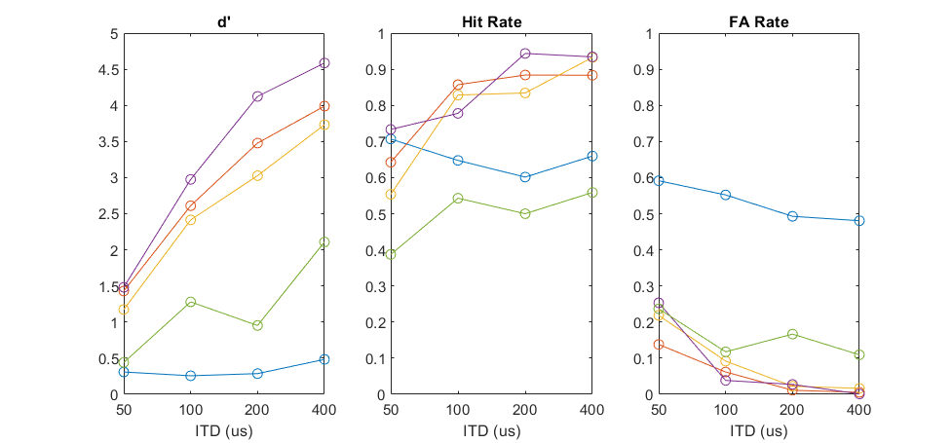
ITD Pilot
ITDs: 50,100,200,400 (60 trials each, 4 blocks of 60 trials), 12 token pairs

Slide 10
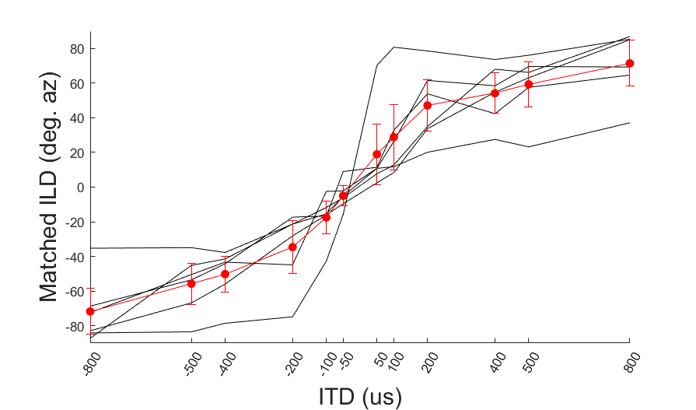
ILD to ITD matching (6 match trials per ITD, 5 subbies)

Slide 11
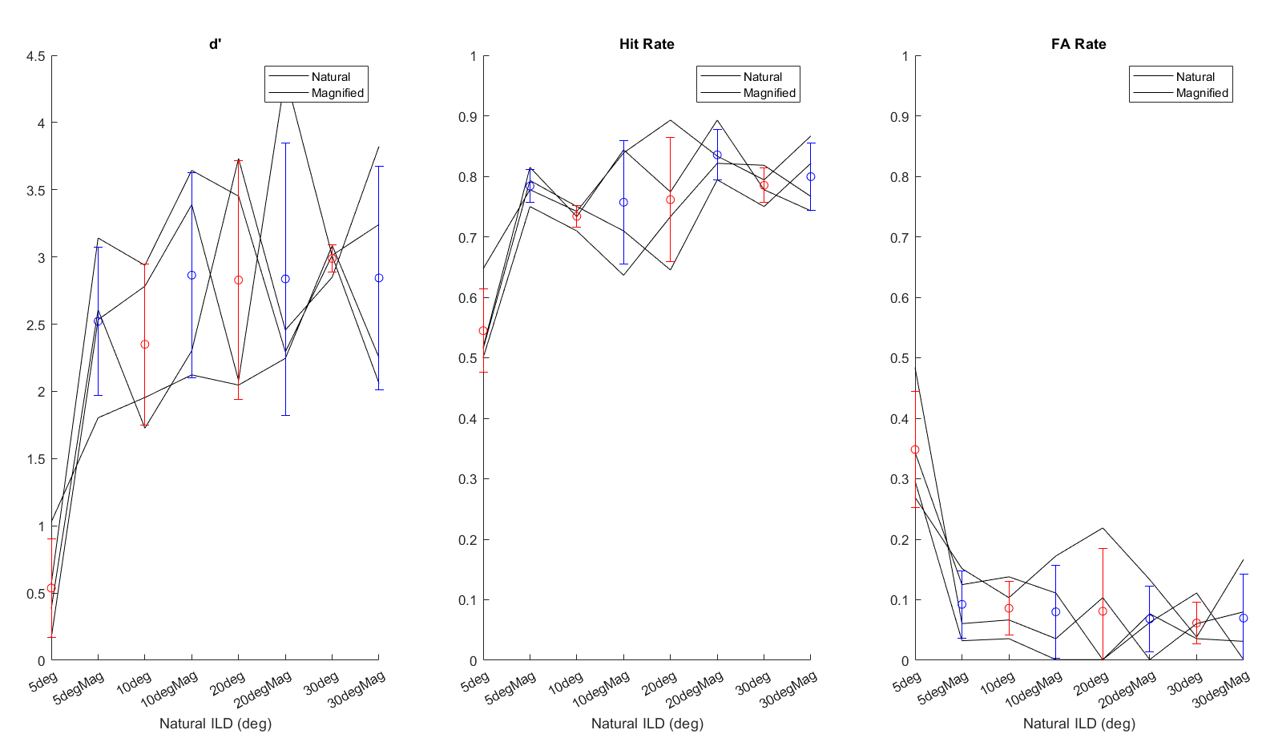
0.2-1.3 s response window

Slide 12
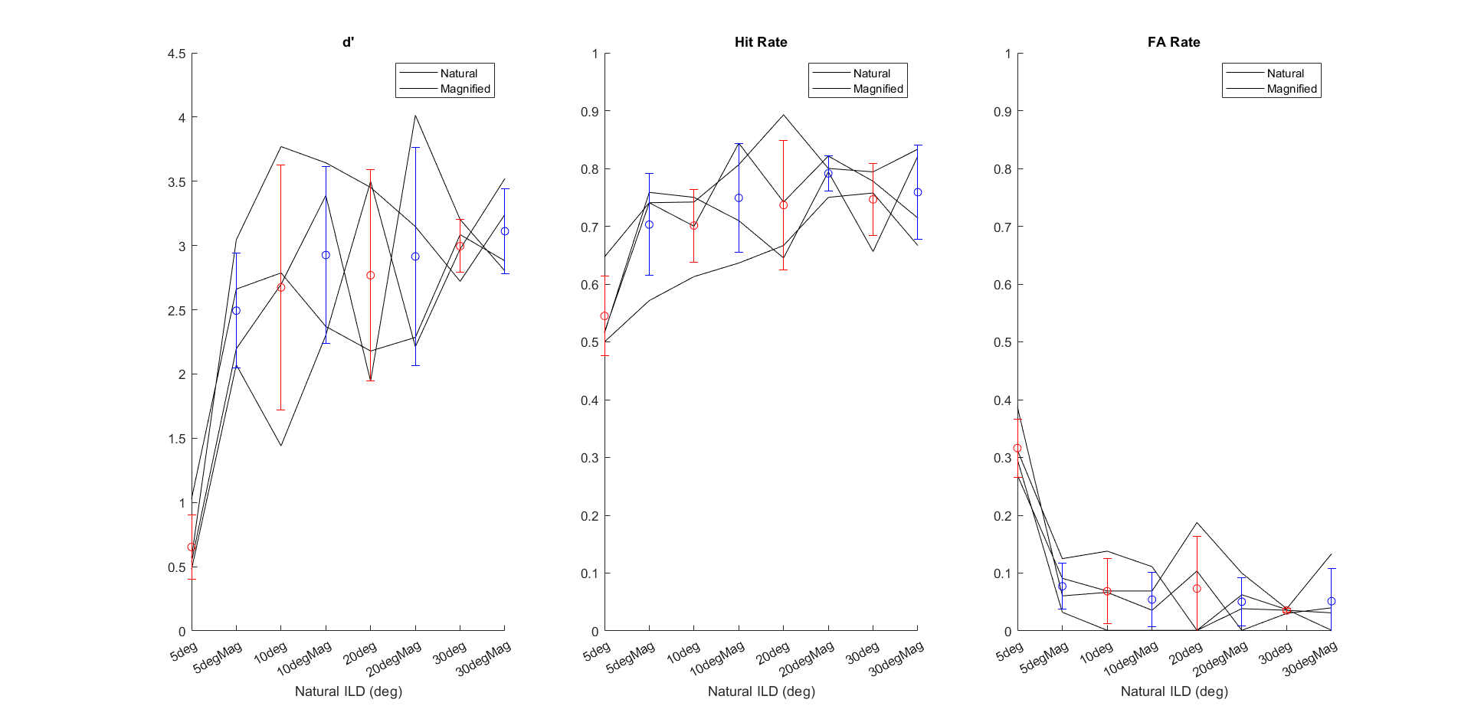
0.2-0.8 s response window

Slide 13
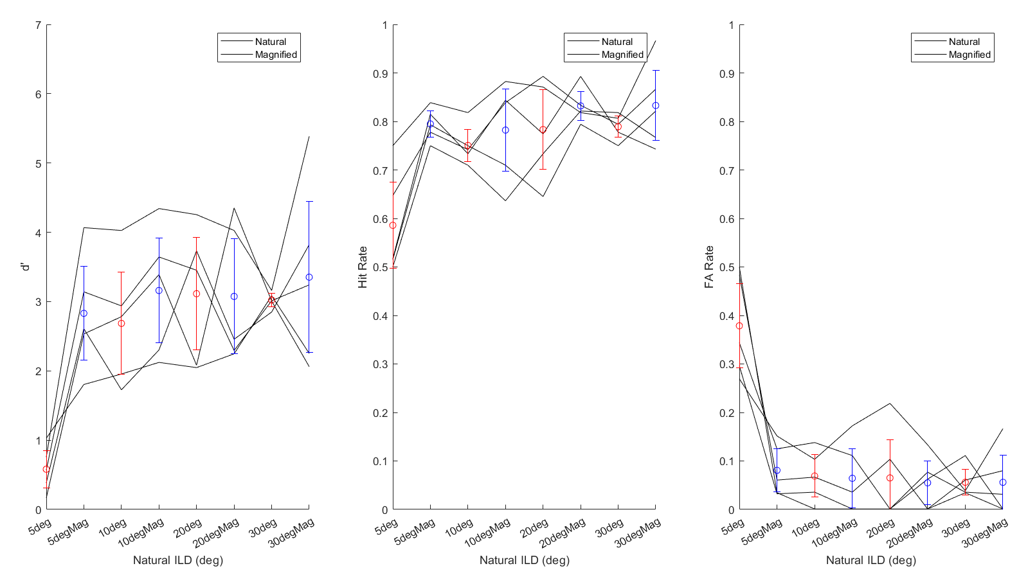

Slide 14
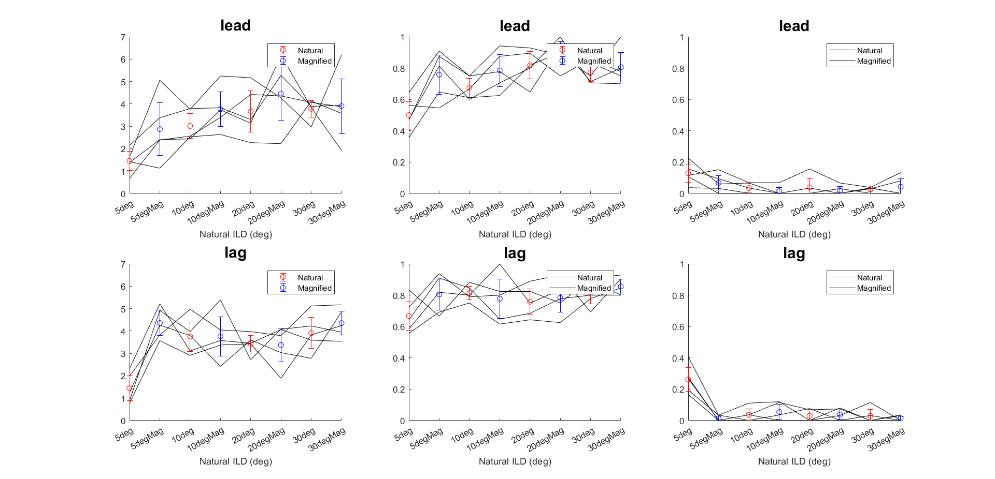
D’
Hit Rate
FA Rate

Slide 15
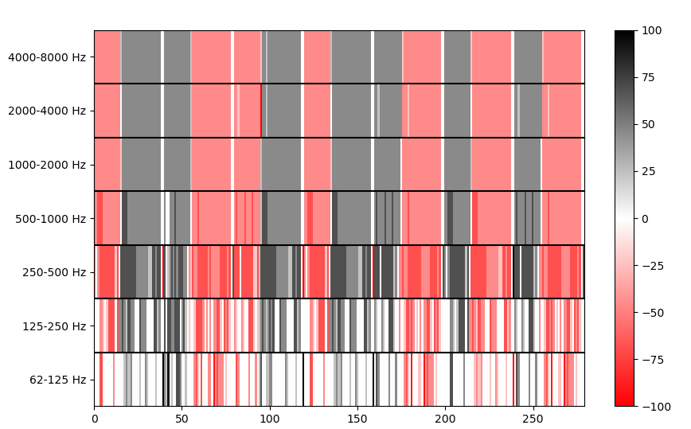
ITD Tracks (5 deg)

Slide 16
First word bash vs. second word bash

Slide 17
Response times by condition & first word and second word

Slide 18
300 ms
?
50 ms
?
250 ms
9.6
?
8 token pairs * 600 ms/pair = 4.8 sec

Slide 19
Current questions
ILD magnification parameters?? Seem to be okay and effective → want to change number of bands/ild attack/max ild?
Can bash occur at the first or last position?
If so → fix the GUI to allow for click time
Does the fNIRS response include the cue period? (factors into how long the stimulus will be)
How many target/Masker token pairs…
….how long is the trial…
….how many trials can we fit in the study…..
…..how many conditions can we fit in the study…..
Check loc_cue_isi
Clipping?! On the low end???

Slide 20
New pilot: 5/10 deg ILD w/w.o. MAG and w/w.o. low pass filter (to reduce the presence of high frequency “sh”)

Slide 21
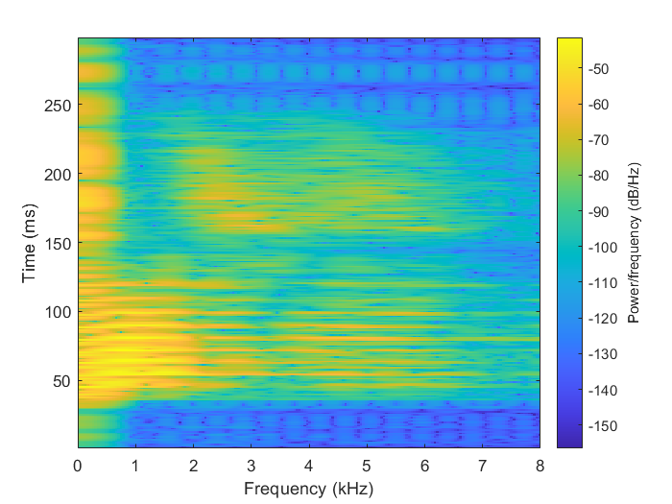
Raw spectrogram of 300 ms “bash”

Slide 22
Spectrogram of “bash” with 2nd order Low pass butterworth filter (cutoff = 1.2 kHz), created using filtfilt

Slide 23
Compare

